Slide 1

Department of Computer Science and Engineering
An Internship on
“FULL STACK DEVELOPMENT”
Internship carried out at
JCE Innovation and Entrepreneurship Foundation
Presented By : Samarth Deshmukh(2JI22CS087)
Guide Name
Prof. Keerti Neeralgimath.

Slide 2
ABOUT COMPANY
Company Profile : JCE Innovation & Entrepreneurship Foundation (JIEF)
What company do?
JIEF was formed to bridge academia and industry by offering incubation support, mentorship, capacity-building programs, and entrepreneurship events targeted at college students and young entrepreneurs.
It functions as a nonprofit/section-8 style foundation focused on building an entrepreneurship and innovation ecosystem for students and early-stage startups.

Slide 3
TECHNOLOGY LEARNED
Frontend Development
HTML5 – Structure of web pages
CSS3 / Tailwind CSS / Bootstrap – Styling and responsive design
JavaScript (ES6+) – Core scripting and DOM manipulation
React.js – Component-based UI development
React Router – Client-side routing and navigation
Axios / Fetch API – API integration and data fetching
Backend Development
Node.js – Server-side JavaScript runtime
Express.js – Backend framework for RESTful APIs
REST API Development – CRUD operations, authentication, middleware

Slide 4
Database
MYSQL – SQL database management
Authentication & Security
JWT (JSON Web Token) – User authentication and authorization
bcrypt.js – Password hashing and security
CORS, Middleware – API protection and request handling
Tools & Technologies
Git & GitHub – Version control and collaboration
VS Code – Code editor and extensions
Postman – API testing
npm / yarn – Package management
Deployment Tools – (Heroku / Vercel / Netlify) if you used any

Slide 5
APPLICATION :
Application Name: Employee Management System
Description of Application:
Developed a role-based Employee Management System where users can securely sign up and log in as either Admin or Employee. Admins can view all employees, add/update/delete employee details, and manage records through a dashboard. The Employee dashboard provides restricted access where employees can only view their own profile details after logging in. This ensures secure and role-specific access across the system.
Developed using React.js (frontend), Spring Boot(backend), and MySQL (database).

Slide 6
Worked ON:
Designed and implemented the user interface using React.js and CSS, including pages for Welcome, Login, Signup, Employee Dashboard, and Admin Dashboard.
Integrated frontend with backend APIs using Axios for user authentication and employee data management.
Developed backend services using Spring Boot, created RESTful APIs for authentication and CRUD operations on employee records.
Modeled and managed relational data in MySQL, including tables for users and employees with role-based access (Admin / Employee).
Implemented role-based authorization, allowing Admin to add, update, delete, and view employees, while Employees can only view their own profile.
Ensured clean form validation, secure password storage, and a user-friendly dashboard experience.

Slide 7
MODULE DEVELOPED AT COMPANY
User Authentication Module – Signup and secure login using email and password with role-based access (Admin / Employee).
Welcome & Navigation Module – Provides entry screen with options for Login and Signup, and redirects users based on their role.
Employee Profile Module (Employee Role) – Allows employees to view their own profile information in a protected dashboard.
Employee Management Module (Admin Role) – Admin can add, view, update, and delete employee details including name, role, salary, and contact info.
Admin Dashboard Module – Displays total employee count and provides access to the employee records table for management.
Backend API Module – Implemented Spring Boot REST APIs for authentication and employee CRUD operations with MySQL as the database.

Slide 8
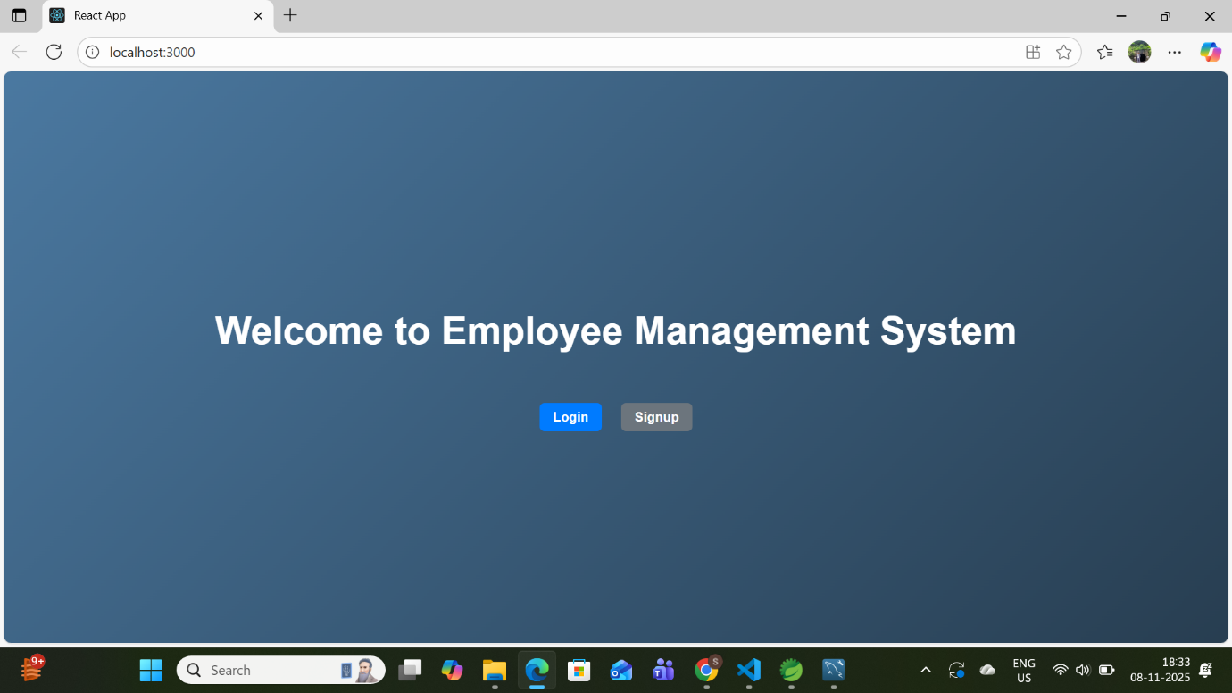
Sample Output

Slide 9
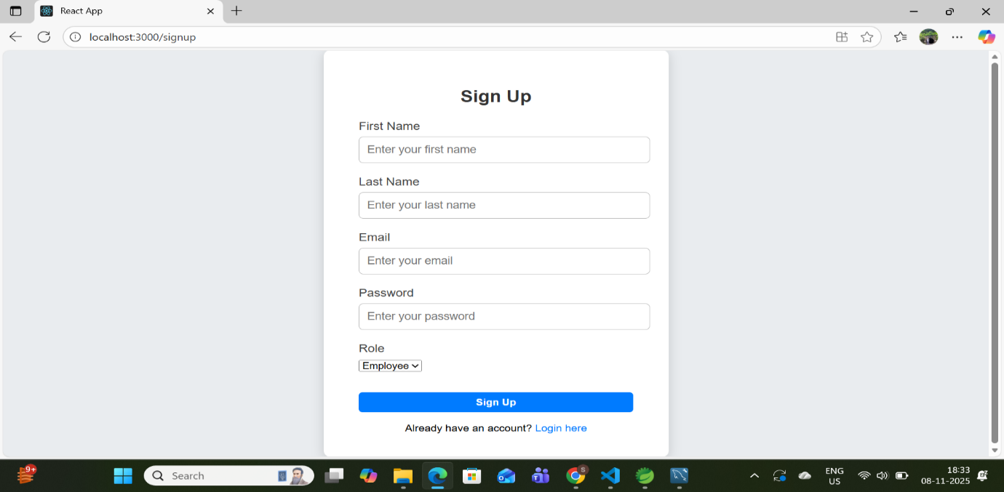
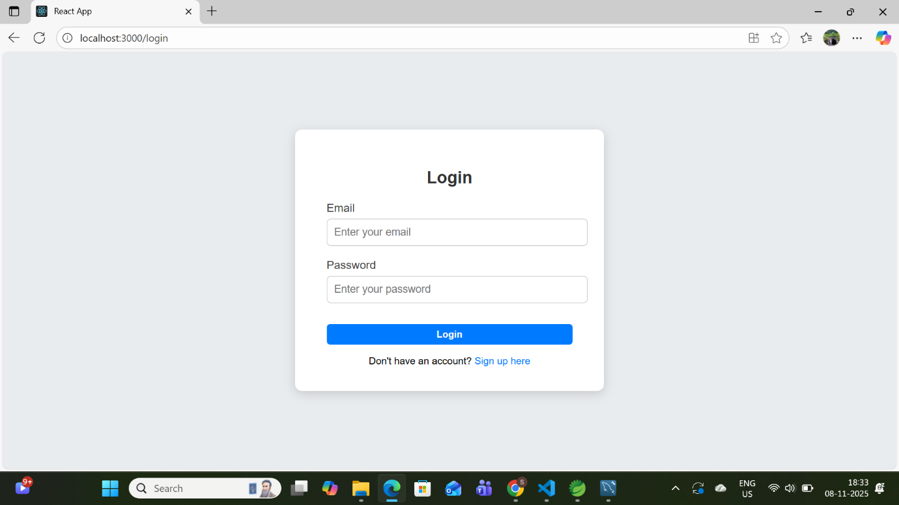

Slide 10
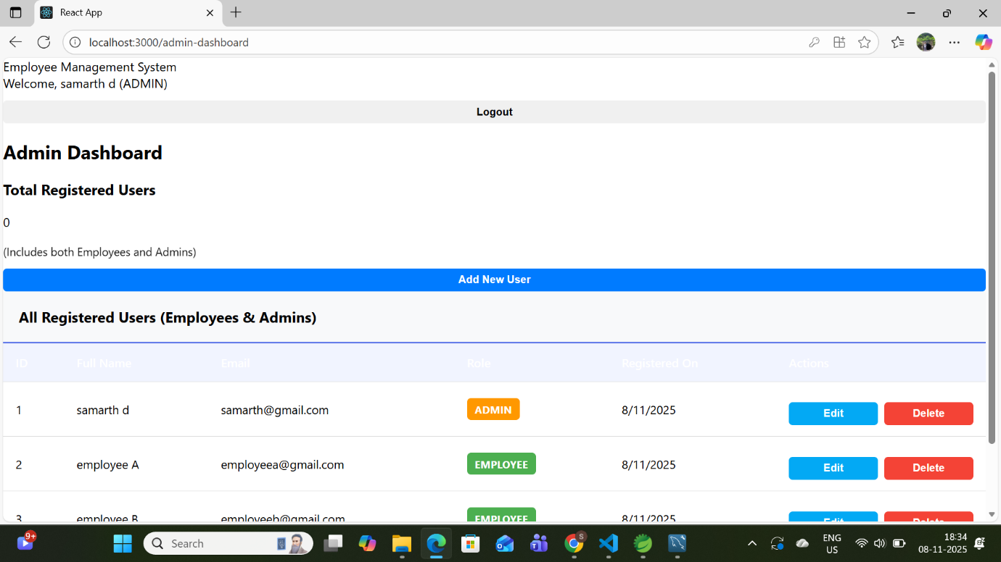
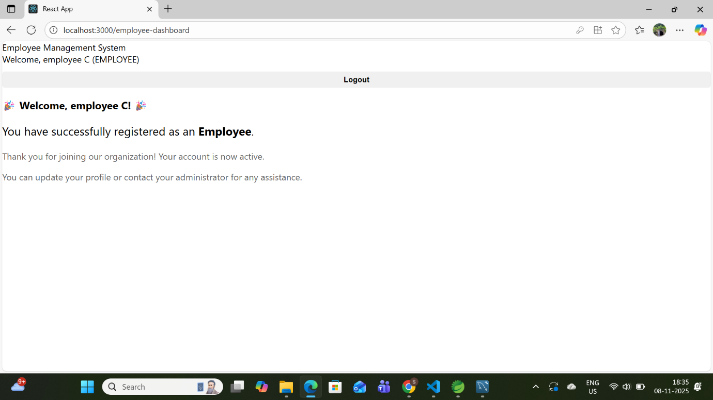

Slide 11
OUTCOME OF INTERNSHIP
Gained hands-on experience in full-stack development.
Learned to design and develop a complete CRUD-based application from scratch.
Improved understanding of REST APIs, database design, and authentication.
Strengthened problem-solving, debugging, and version control skills.
Enhanced confidence to handle real-world projects and collaborate effectively.

Slide 12
Thank
You

